Slide 1
Introduction to CapSense in ModusToolbox
Bragadeesh Viswanathan
Applications Engineer
21st May, 2020

Slide 2
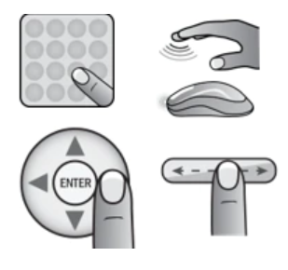
Agenda
Introduction to CapSense technology
Self-Capacitance vs Mutual Capacitive sensing
High Level Hardware Architecture
Basic terminologies
CapSense Tuning
CapSense Middleware library
CapSense Configurator in ModusToolbox 2.x
Demo Project
CapSense Data Structure
CapSense Tuner GUI
Advanced Topics

Slide 3
CapSense Technology
CapSense technology measures changes in capacitance between a plate (the sensor) and its environment to detect the presence of a finger on or near a touch surface
Features:
Robust touch sensing
Liquid tolerant operation
Low electromagnetic interference (EMI) performance
SmartSense™ Auto-Tuning technology
Low power consumption
Wide operating voltage range (1.71 V – 3.6 V) – PSoC 6
Proximity sensing

Slide 4
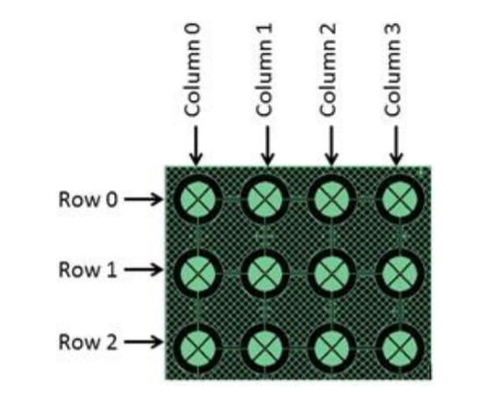
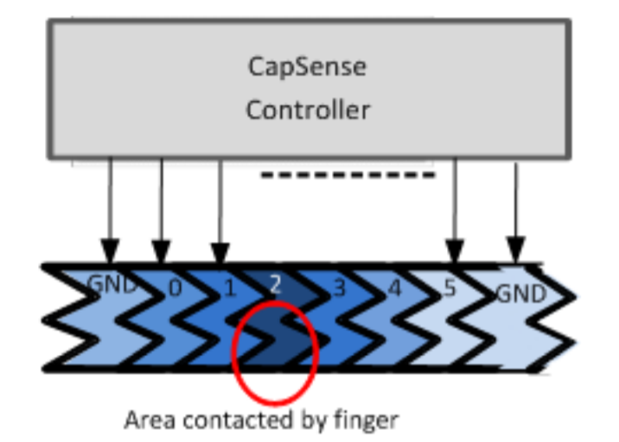
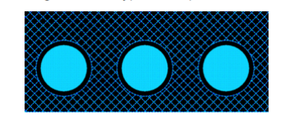
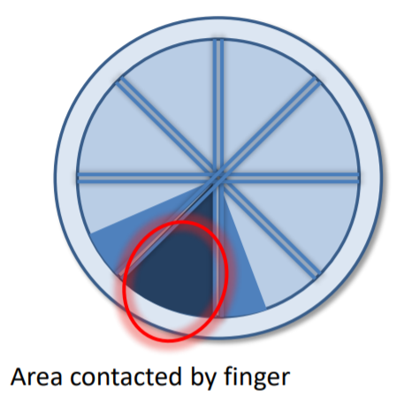

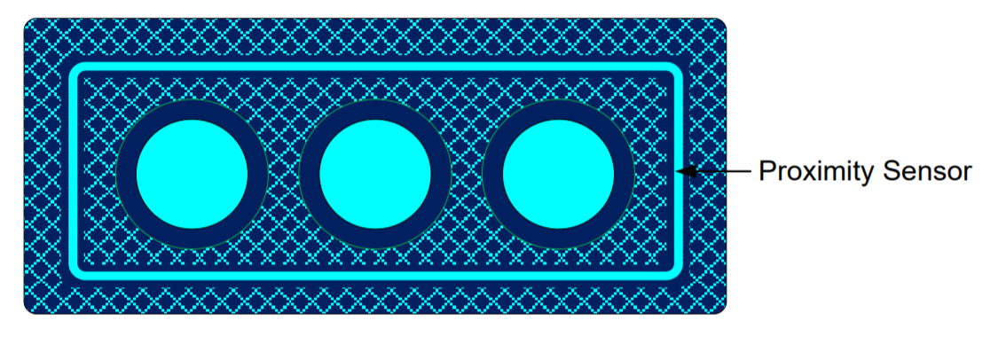
CapSense Sensors
Cp
Buttons
Matrix Buttons
Linear Slider
Radial Slider
Touchpad/Trackpad
Proximity sensor

Slide 5
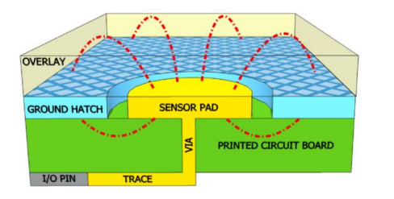
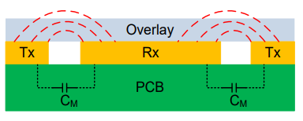
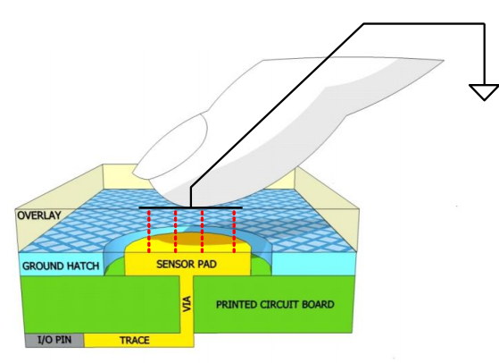
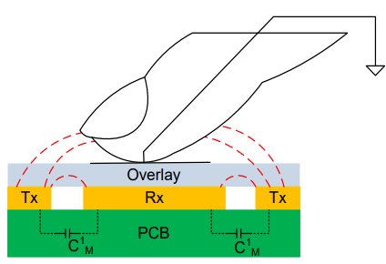
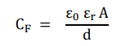
Self Capacitance vs Mutual Capacitance
Self Capacitance
Mutual - Capacitance
Cm
Cp
Cf + Cp
Cm - dCm

Slide 6
When to use CSD , When to use CSX
Parameter/ Requirement | CSD | CSX
Pin constraints | Requires more pins | Requires Less pins(1)
High Cp designs | ✗ | ✓
Proximity sensing | ✓ | ✗
Overlay thickness | Thick overlays | Thin overlays (1 - 4 mm)
Liquid tolerance | ✓ | ✓(2)
Multi touch performance in matrix buttons | ✗(3) | ✓
Spring sensors | ✓ | ✗
VDD noise | ✓(4) | ✗
(1) If sensors required is greater than 7. If there are X * Y sensors requirement, CSX requires only X + Y GPIO whereas CSD requires X * Y GPIO
(2) CSX + CSD for liquid tolerance. It is a special firmware. Contact our community support for further information.
(3) Ghost touch – (wrong reporting of fingers upon multi-touch)
(4) IDAC sourcing mode

Slide 7
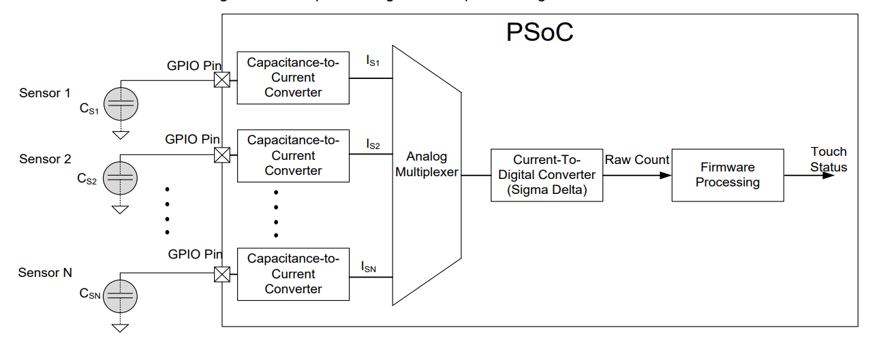
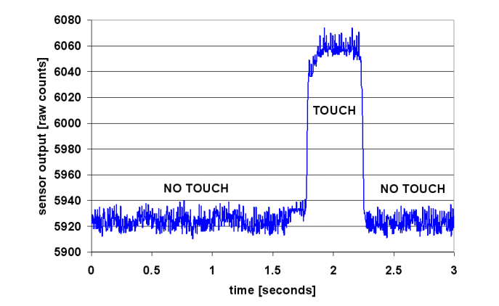
CapSense block - CSD
Each GPIO has a switched-capacitance circuit that converts the sensor capacitance into an equivalent current
An analog multiplexer then selects one of the currents and feeds it into the current to digital converter
The current to digital converter is similar to a sigma delta ADC. The output count of the current to digital converter, known as raw count, is a digital value that is proportional to the self-capacitance between the electrodes.

Slide 8
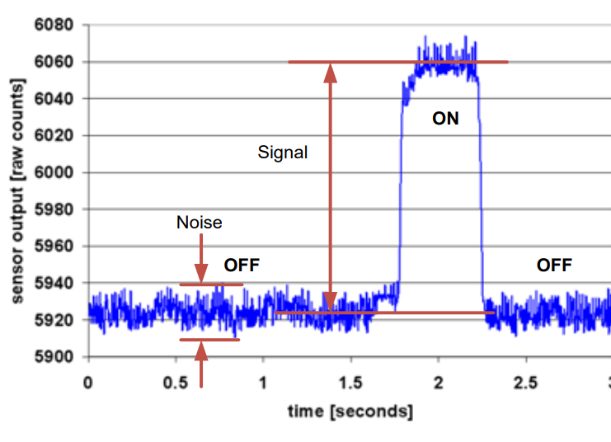
CapSense – Basic terminologies
RawCounts
Digital count value that is proportional to the self-capacitance between the electrodes in case of CSD and Mutual capacitance between electrodes in case of CSX
Baseline
Filtered rawcounts at no touch condition
Difference Counts
RawCounts(with touch) – Baseline (Signal)
Signal to Noise ratio
Ratio of CapSense signal to CapSense noise. Recommended SNR is 5 : 1

Slide 9
CapSense Tuning
Why should you tune sensors?
Reliable touch detection
Power consumption
Response time
Achieving Noise Immunity
Less Emissions

Slide 10
CapSense Tuning – SmartSense vs Manual Tuning
SmartSense Autotuning:
All parameters – set by component
Reduced design cycle time and easy to use
Limitations on memory and supported parasitic capacitance
Less control over performance
Manual Tuning:
Strict control over parameter settings such as response time, power consumption and noise immunity.
Higher parasitic capacitance designs

Slide 11
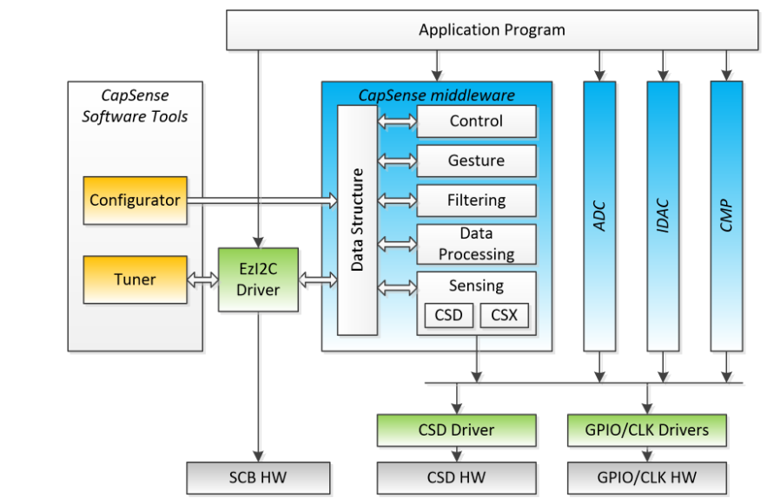
CapSense Middleware Library
The CapSense Configurator tool, which is a configuration wizard to create and configure CapSense widgets
API to control the design from the application program.
The CapSense Tuner tool for real-time tuning, testing, and debugging, for easy and smooth designing of human interfaces on customer products

Slide 12
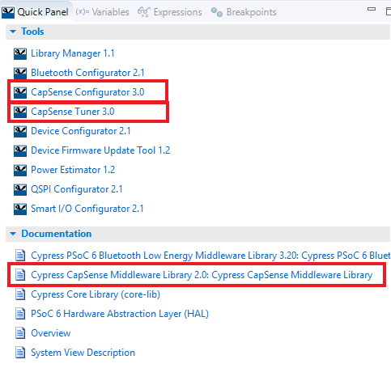
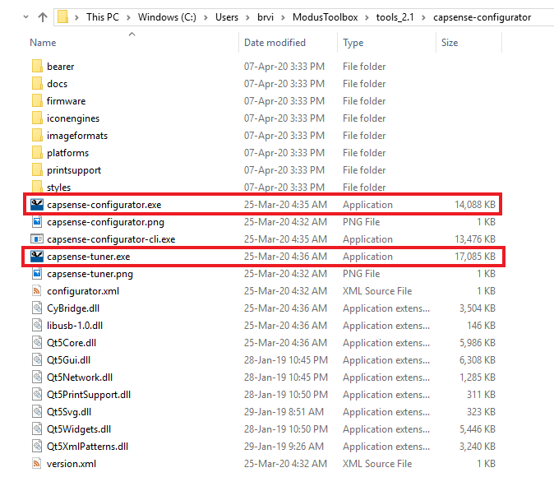
CapSense Configurator and CapSense Tuner GUI

Slide 13
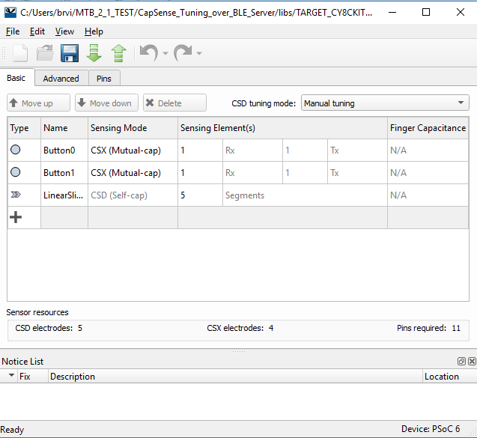
CapSense Configurator
Used to create and configure CapSense widgets
Generate code to control application firmware

Slide 14
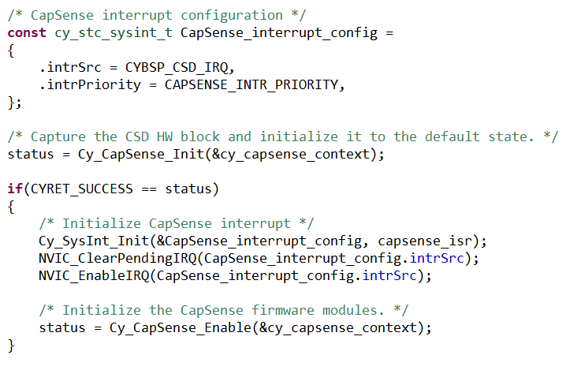
Demo Project – CapSense Initialization
Include cycfg_capsense.h to include CapSense Middleware and Configurator settings into your project
Initialize CapSense
CapSense interrupt configuration
Initialize CapSense hardware
Initialize CapSense interrupt
Enable CapSense interrupt
Initialize CapSense firmware modules

Slide 15
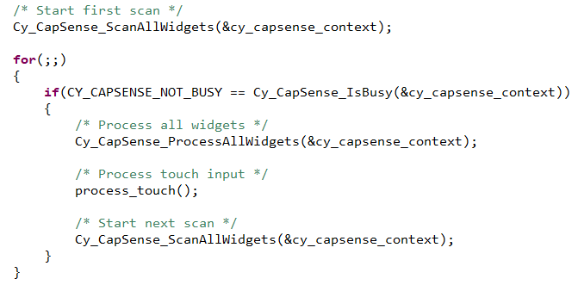
Demo Project – CapSense Scanning and Processing results
Application for ever loop
Is CapSense Busy?
No
Process Widgets
Process Touch
Trigger Scan

Slide 16
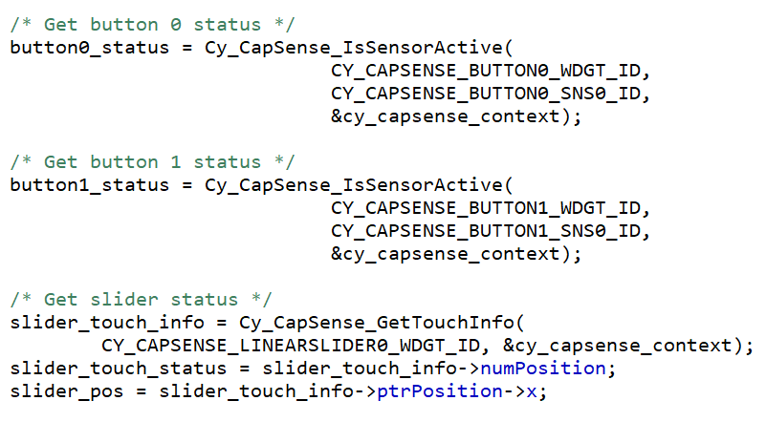
Demo Project – Check Widget Status
Cy_CapSense_IsSensorActive()
Reports whether the specified sensor in the widget detected touch.
Cy_CapSense_GetTouchInfo()
Reports the details of touch position detected on the specified touchpad, matrix buttons or slider widgets.
Similar APIs
Cy_CapSense_IsWidgetActive()
Cy_CapSense_IsProximitySensorActive()
Cy_CapSense_IsAnyWidgetActive()

Slide 17
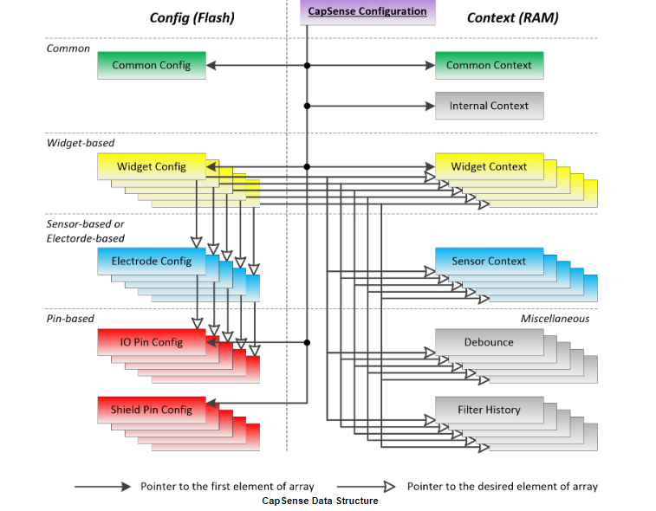
CapSense Data Structure
The Data Structure is the only data container in the CapSense middleware.
It serves as storage for the configuration and the output data.
All CapSense modules use the data structure for the communication and data exchange.
Data is split between RAM and Flash to achieve a reasonable balance between resources consumption and configuration / tuning flexibility at runtime and compile time

Slide 18
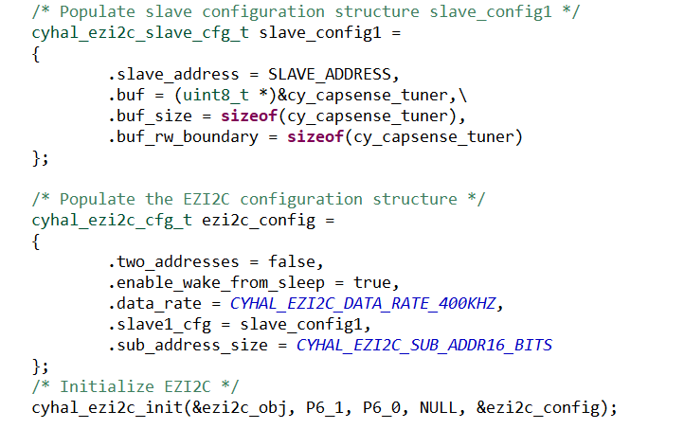
Demo Project – Adding Tuner Support using EZI2C interface
Initialize an EZI2C interface to communicate with CapSense Tuner GUI
Expose cy_capsense_tuner structure as the read/ write buffer in EZI2C interface

Slide 19
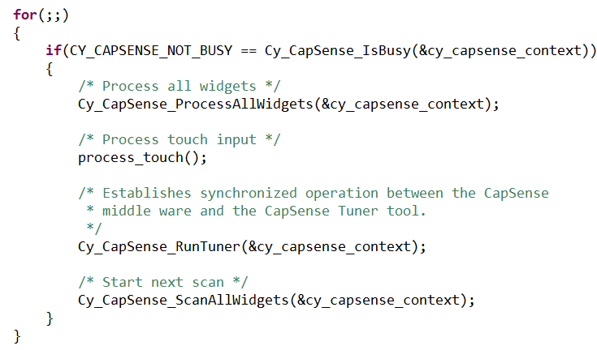
Demo Project – Adding Tuner Support using EZI2C interface
Calling Cy_CapSense_RunTuner() from the application is optional.

Slide 20
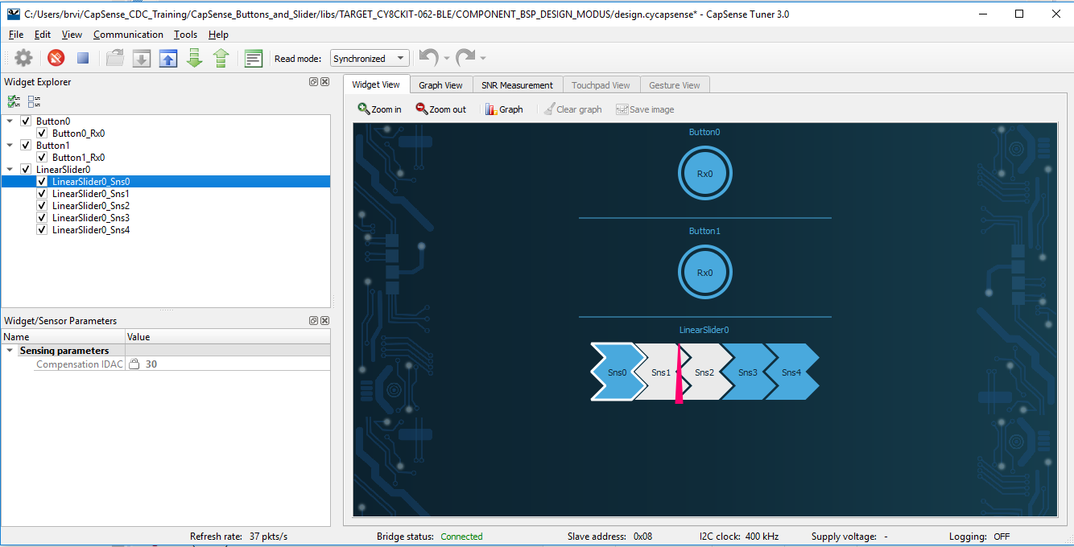
CapSense Tuner GUI
The CapSense Tuner tool for real-time tuning, testing, and debugging, for easy and smooth designing of human interfaces on customer products

Slide 21
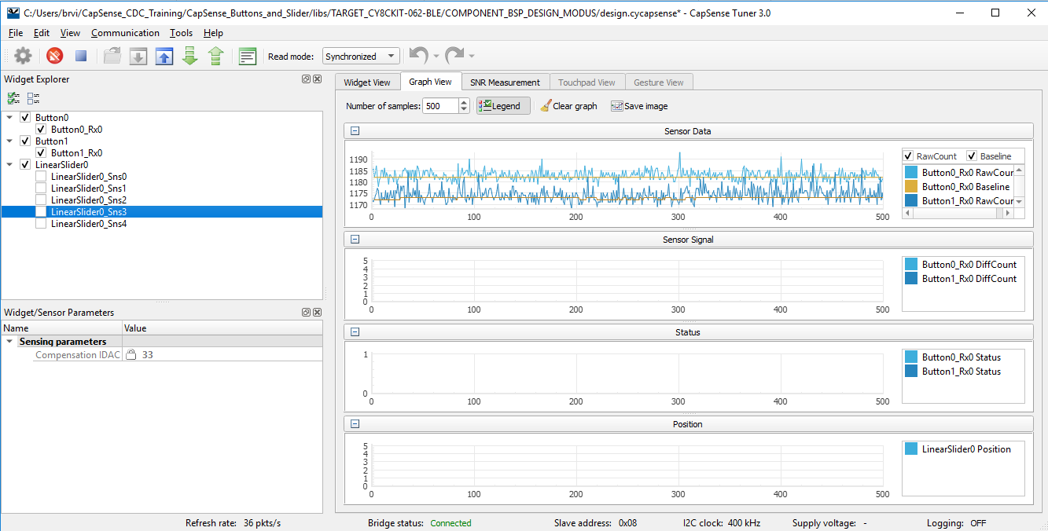
CapSense Tuner GUI – View CapSense raw data

Slide 22
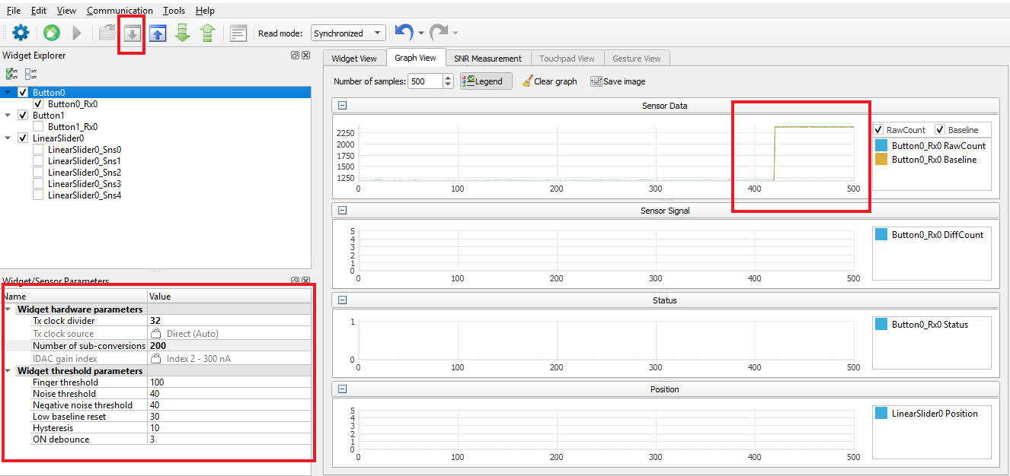
CapSense Tuner GUI – Change hardware/ software parameters

Slide 23
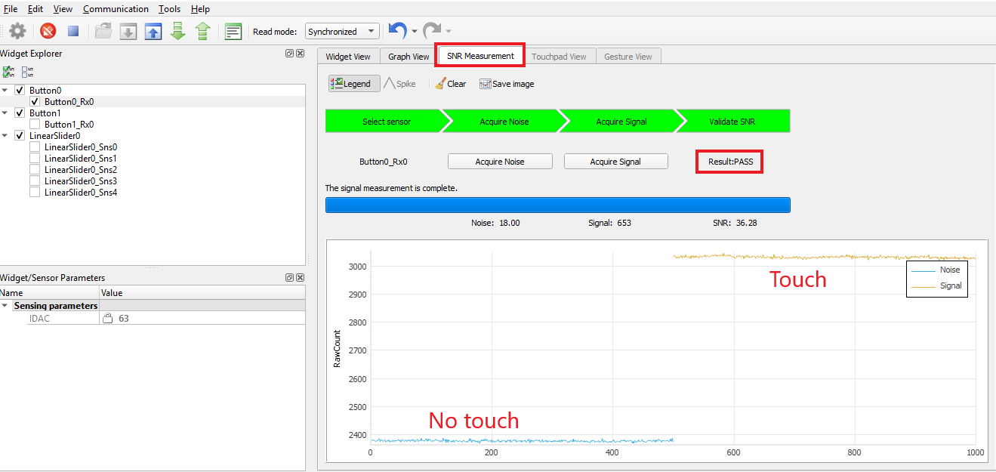
CapSense Tuner GUI – SNR Performance

Slide 24
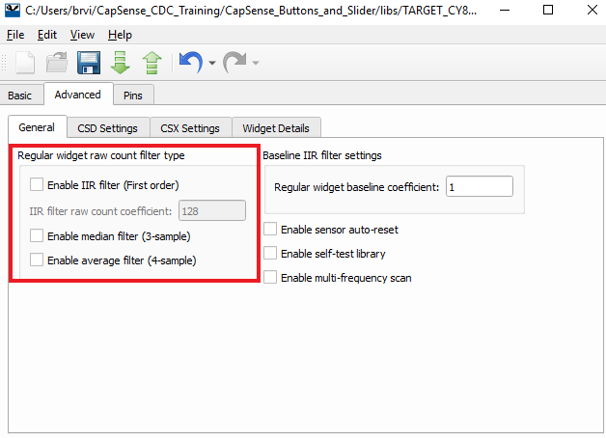
Advanced Topics – Firmware filters
IIR filter - Eliminates high-frequency noise
Median filter - Eliminates spike noise.
Average filter - Eliminates periodic noise
Limitations:
Increases memory consumption depending on filter
IIR filter slows down response
Increases processing time and hence power consumption

Slide 25
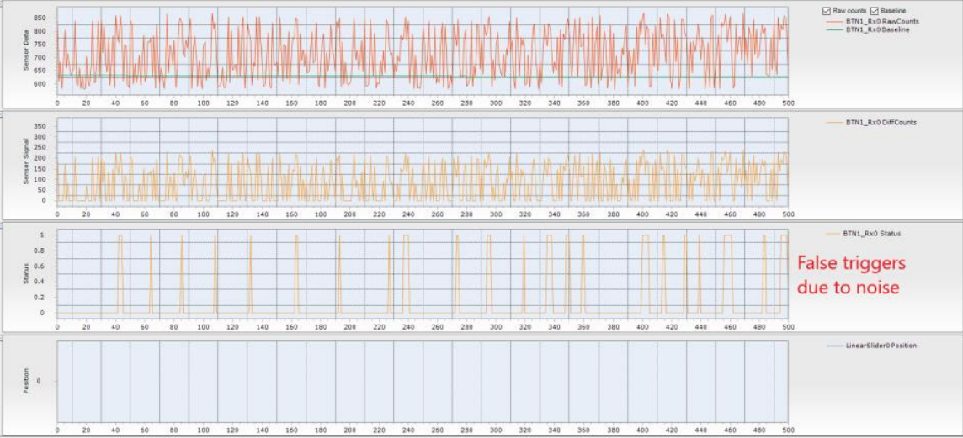
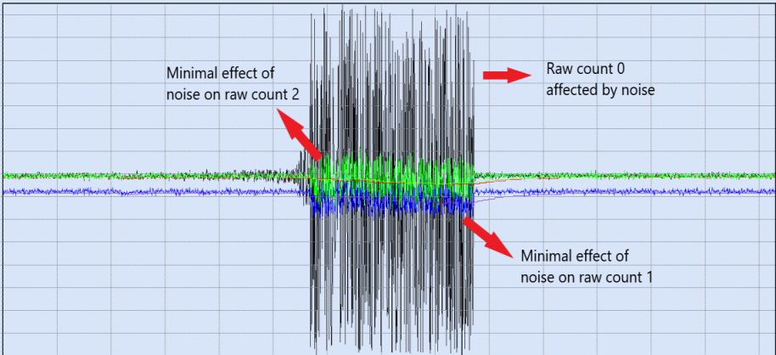
Advanced Topics – Multi Frequency Scanning (MFS)
MFS is used to prevent false touch detection in the presence of external noise at a particular frequency
Each sensor is scanned with three different frequencies
Median filter is applied on the results to eliminate noise

Slide 26
Advanced Topics – Multi Frequency Scanning
Points to consider when using MFS
Enabling MFS increases RAM usage by three times approximately
Increases the sensor scan duration by three times
The SmartSense (Full Auto-Tune) and the Multi-frequency scan features are mutually exclusive
Use CapSense Tuner GUI to view the rawcounts for three different channels.

Slide 27
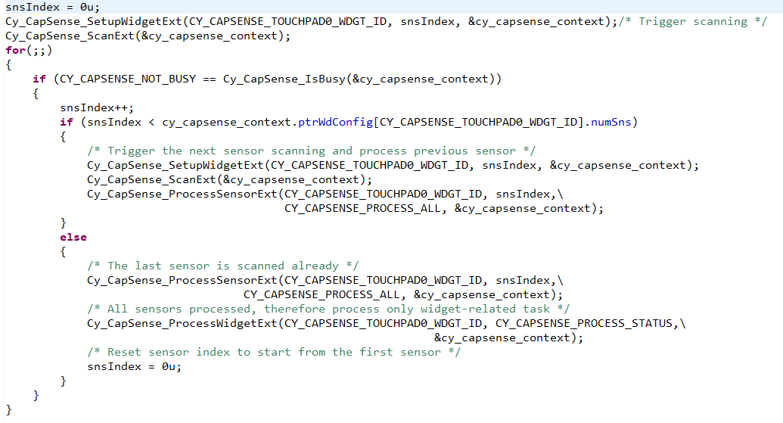
Advanced Topics – Pipeline scanning using low level APIs
Custom scanning sequence
Reduce the total scan/ process time
Increase the refresh rate
Decrease the power consumption

Slide 28
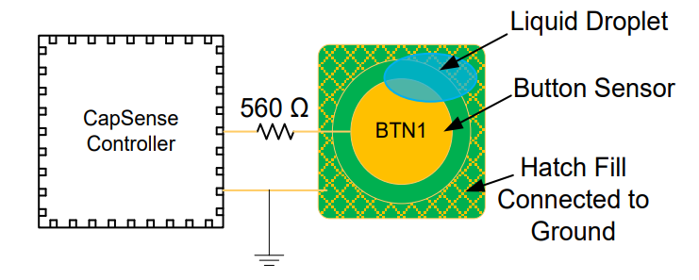
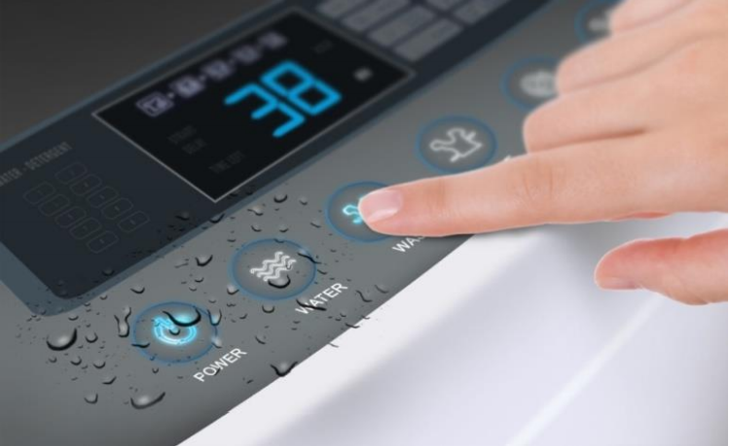
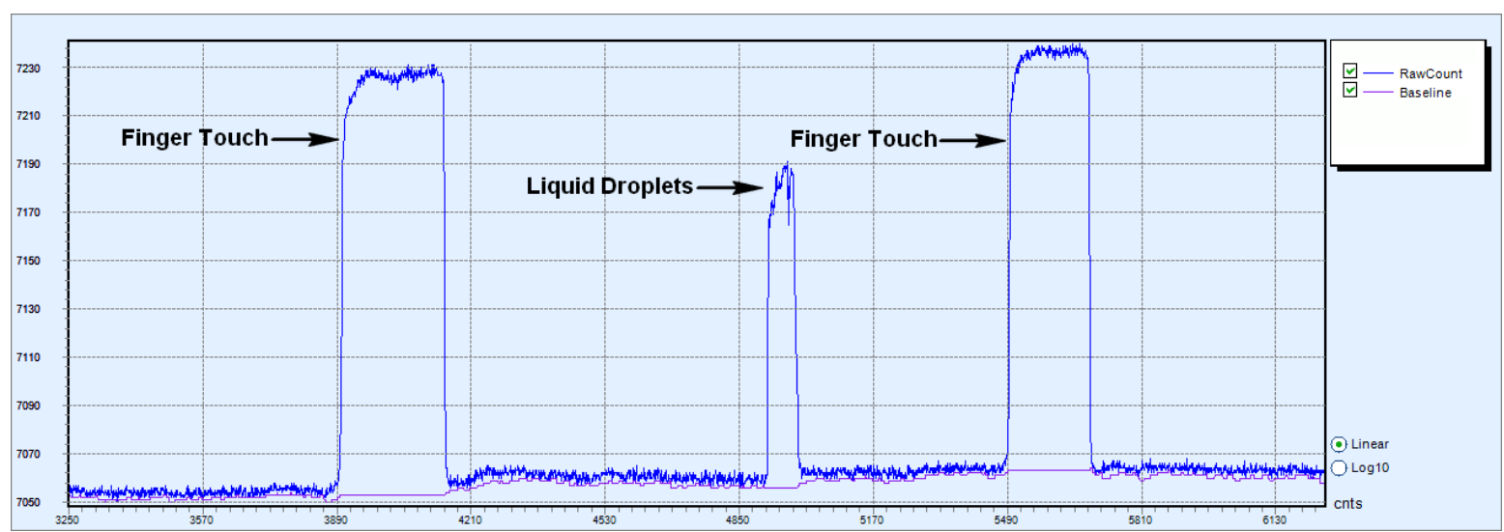
Advanced topics - Liquid tolerance in CapSense designs
When hatch fill around the sensor is grounded, the increase in raw count when a liquid droplet falls on the sensor surface may be equal to the increase in raw count due to a finger touch. In such a situation, sensor false triggers might occur.

Slide 29
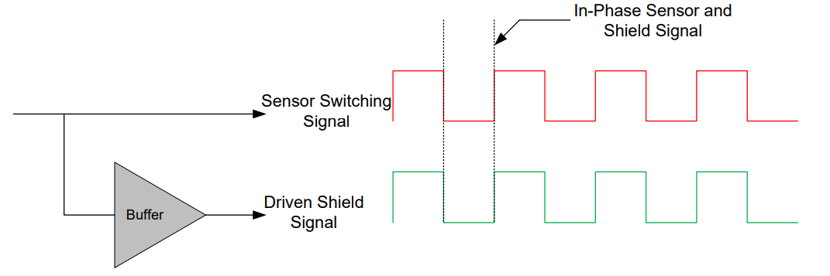
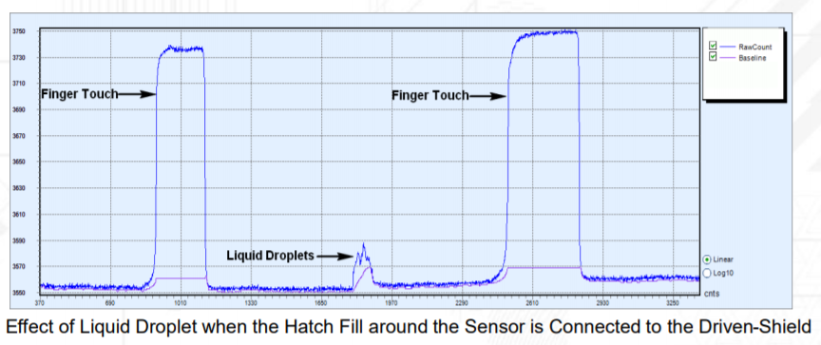
Liquid tolerance in CapSense designs - Shield Electrode
The driven-shield signal is a buffered version of the sensor-switching signal
It has the same amplitude, frequency, and phase as that of sensor switching signal
Buffer provides sufficient current for the driven-shield signal to drive the high parasitic capacitance of the hatch fill
The increase in raw count when a water droplet falls on the sensor will be very small.

Slide 30
Advanced topics – Built in Self Test (BIST)
Available from CapSense MW 2.10 (to be released soon…)
HW Tests – To confirm the CSD block and sensor hardware (external to chip) function correctly:
Chip analog-routing verification
Pin faults checking
PCB-trace opens / shorts checking
Sensors capacitance measurement
VDDA measurement.
FW Tests – To confirm the integrity of data used for decision-making on the sensor status
Global and widget specific configuration verification
Sensor baseline duplication
Sensor raw count and baseline are in the specified range.

Slide 31
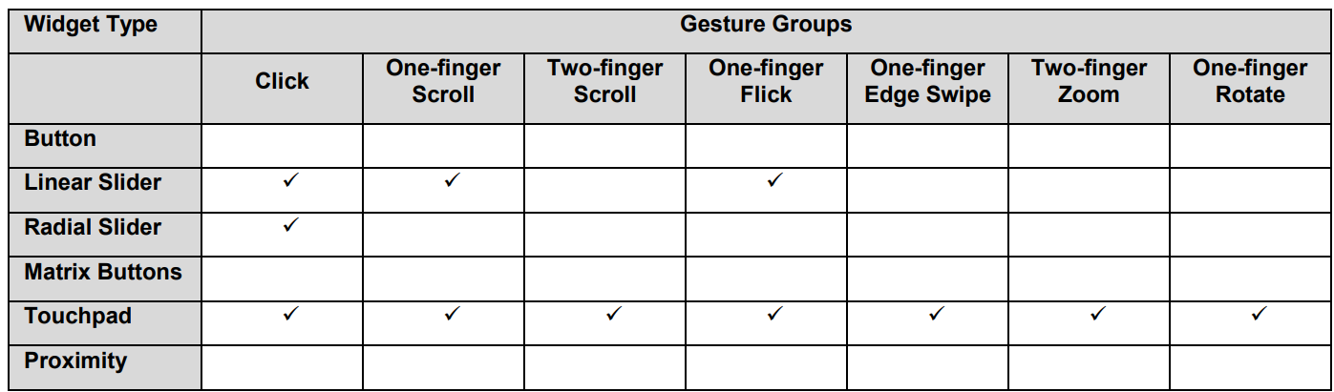
Advanced Topics - Gestures
Supports one-finger and two-finger gestures on Sliders and touchpad.

Slide 32
Advanced Topics - Gestures
Use the high level function, Cy_CapSense_DecodeWidgetGestures() to process all gestures for a specified widget.
Gesture detection functionality requires a timestamp for its operation. The timestamp should be initialized and maintained in the application program prior to calling this function.
Call Cy_CapSense_IncrementGestureTimestamp() periodically from the application layer or register a periodic callback such as SysTick to keep the timestamp updated.

Slide 33
Resources
PSoC® 4 and PSoC 6 MCU CapSense® Design Guide
Cypress CapSense Middleware Library
ModusToolbox® Software Environment
ModusToolbox™ CapSense® Tuner Guide
ModusToolbox™ CapSense® Configurator Guide
Code Examples: Github repository

